Slide 1
Context-Aware Weighted KNN with Locally Adaptive k
Anieesh Saravanan
03/28/25

Slide 2
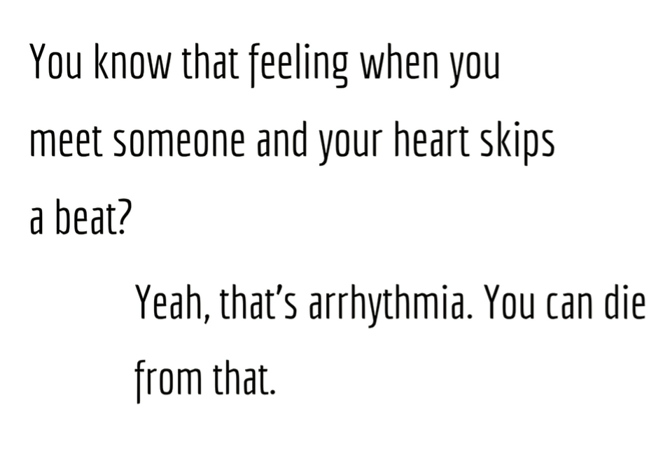
https://rusafu.com/quotes/tag/arrhythmia/

Slide 3
Table of contents
01
02
03
04
Project Overview
Preprocessing
Relevance and Dataset Characteristics
Preparing the Dataset
for Analysis
Analysis
Conclusion
Configuring Parameters and Classification
Results and Future Work

Slide 4

00
Introduction

Slide 5
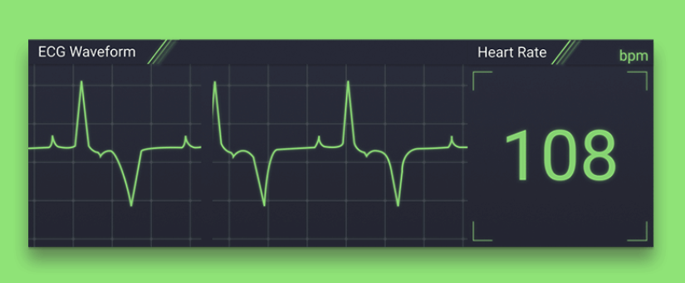
Project Goal
Develop a binary classification model for arrhythmia
Diagnose patients with arrhythmia based on patient biometrics and ECG readings
Streamline diagnosis process with supplementary outlook of data

Slide 6

Arrhythmia Overview
Arrhythmia refers to irregular heartbeats
Antiarrhythmic medications/therapies exist
No simple guidelines for diagnosis
Widely varying clinical manifestations and minimal warning signs
Even experienced cardiologists may misinterpret ECG patterns

Slide 7
Common Myths
Myth: Arrhythmia always presents with severe, dramatic symptoms
Fact: Many arrhythmias can be subtle or even asymptomatic
Myth: Only unhealthy/elderly individuals develop arrhythmia
Fact: Arrhythmia can occur in healthy individuals (without heart conditions)
Myth: Abnormal heart rhythms are always obvious and easy to detect
Fact: Many arrhythmias require specialized diagnostic tools (like extended ECG monitoring) that may not be apparent with a simple pulse check

Slide 8
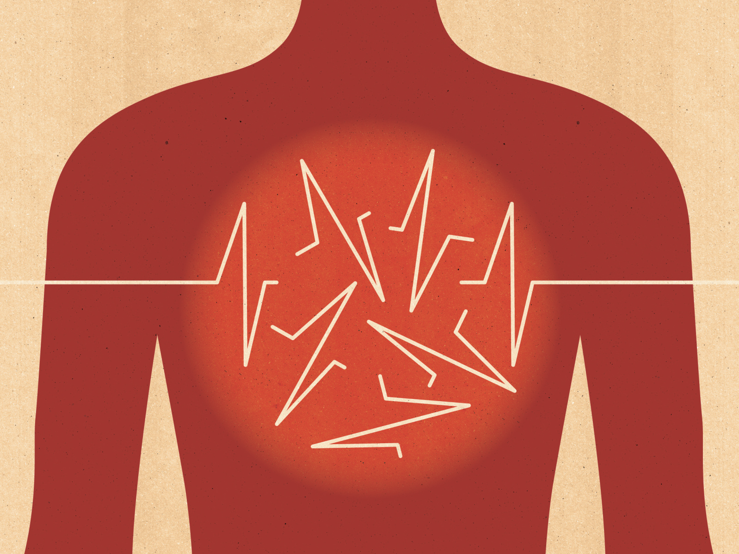
Impact
In 2021, arrhythmia was mentioned on at least 232,030 death certificates

Slide 9
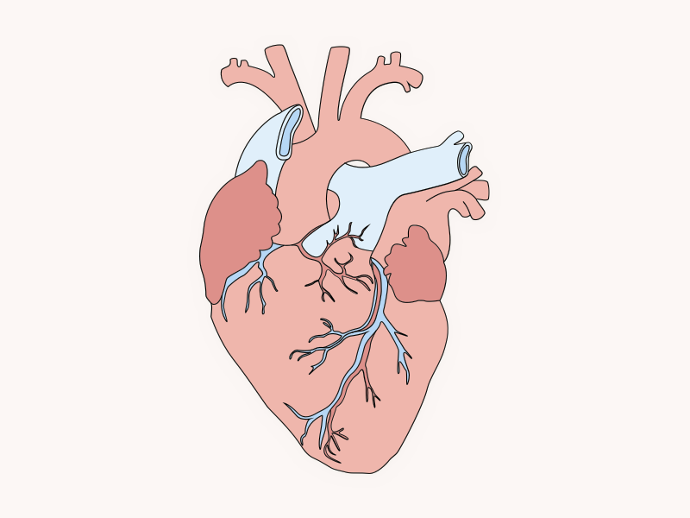
01
Project Overview

Slide 10
Dataset Overview
Quantitative/Categorical dataset with 452 instances and 279 attributes
Class attribute is the diagnosis of the patient (nonarrhythmia or type of arrhythmia)
Sourced from UCI and originally compiled by H. Altay Guvenir
Missing values: instances regarding vector angles (ECG electrode similarity)
Class distribution: 54.20% nonarrhythmia, 45.80% arrhythmia

Slide 11
Attributes
class: Class Code 01-16
Code 01: Normal
Code 02: Ischemic changes (Coronary Artery Disease)
Code 03: Old Anterior Myocardial Infarction
Code 04: Old Inferior Myocardial Infarction
…
p. Code 16: Others
age: Age in years, linear
sex: Sex (0 = male; 1 = female), nominal
height: Height in centimeters, linear
weight: Weight in kilograms, linear
QRSduration: Average of QRS duration in milliseconds, linear
PRinterval: Average duration between onset of P and Q waves in milliseconds, linear
Q-Tinterval: Average duration between onset of Q and offset of T waves in msec., linear
Tinterval: Average duration of T wave in milliseconds, linear
Pinterval: Average duration of P wave in milliseconds, linear
…
279. chV6_QRSTA: Of channel V6

Slide 12
Related Work
Signal Pre-Processing and Fixed-Feature Extraction Classification of Arrhythmia using KNN-Classifier Heart Arrhythmia Classification Using Machine Learning Algorithms
Classifier Comparisons with Feature Selection Classification of Arrhythmia
Algorithmic Approaches with Feature Projection A Supervised Machine Learning Algorithm for Arrhythmia Analysis Identifying Best Feature Subset for Cardiac Arrhythmia Classification

Slide 13
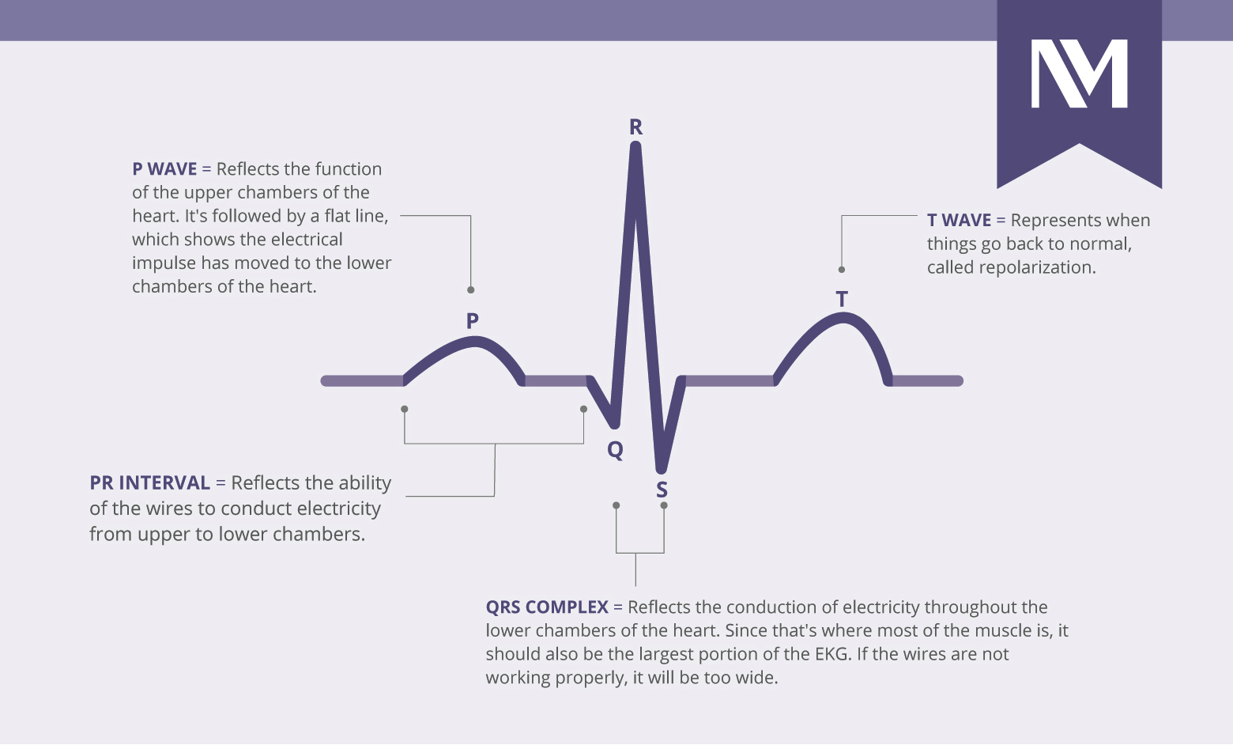
02
Preprocessing

Slide 14
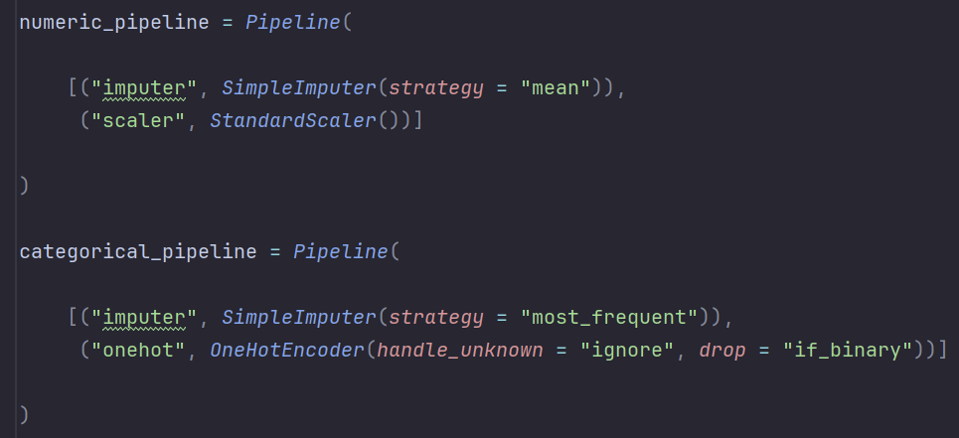
Missing Value Handling
Imputed using the mean for numerical features and mode for categorical features.
scikit-learn pipelines were used to streamline preprocessing

Slide 15
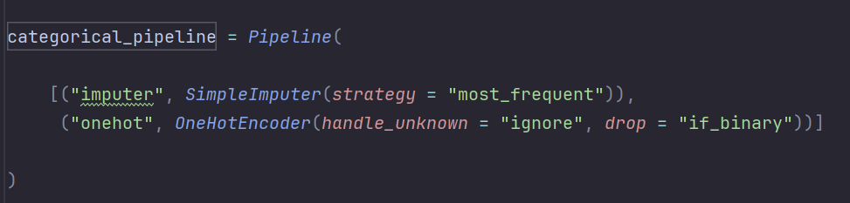
Feature Encoding
Used one-hot encoding on all categorical features (necessary for distance computations)
Encodings using scikit-learn functionality

Slide 16
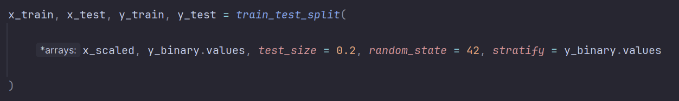
Dataset Splitting
Training Set: 80% of data for model training
Testing Set: 20% for unbiased evaluation of model performance
Split with stratified distribution using scikit-learn functionality

Slide 17
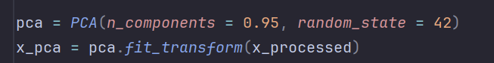
Feature Selection
Preserves 95% of the variance while avoiding the curse of dimensionality
Eliminates all redundancy from correlated features.

Slide 18
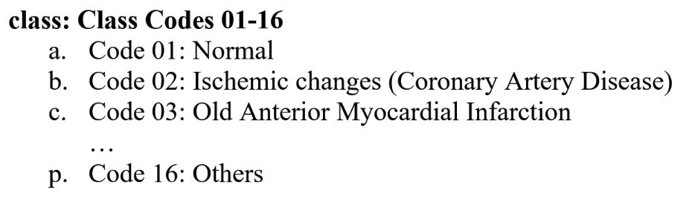
Converting Dataset to OvR
Class Code 1 is separated from Class Codes 2 - 16

Slide 19
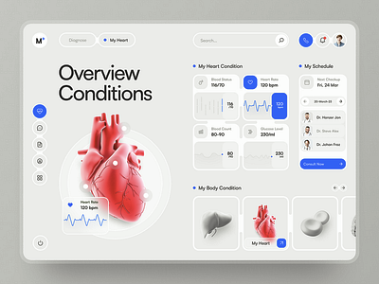
03
Analysis

Slide 20
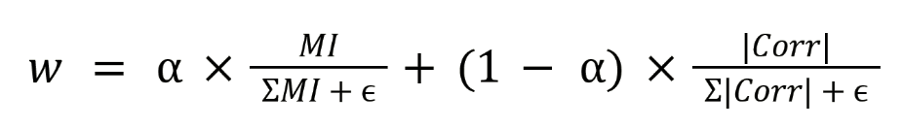
Feature Weighting
Mutual Information (MI):
Captures nonlinear dependencies between features and target
Absolute Pearson Correlation:
Quantifies linear relationships

Slide 21
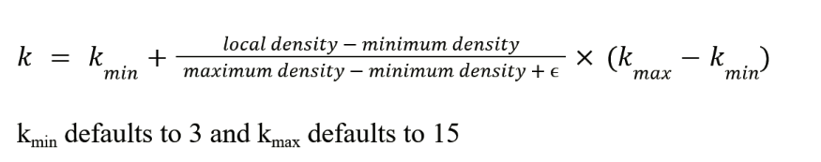
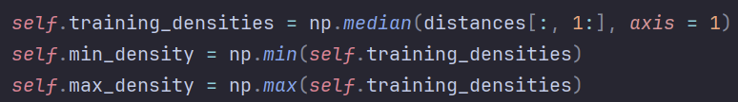
Neighborhood Size
“distances” variable contains distances from r nearest neighbors

Slide 22
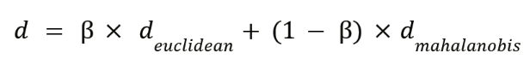
Distance Metrics
Weighted Euclidean Distance:
Incorporates feature weights directly
Local Mahalanobis Distance:
Uses a locally computed covariance matrix to account for interdependencies in features.

Slide 23
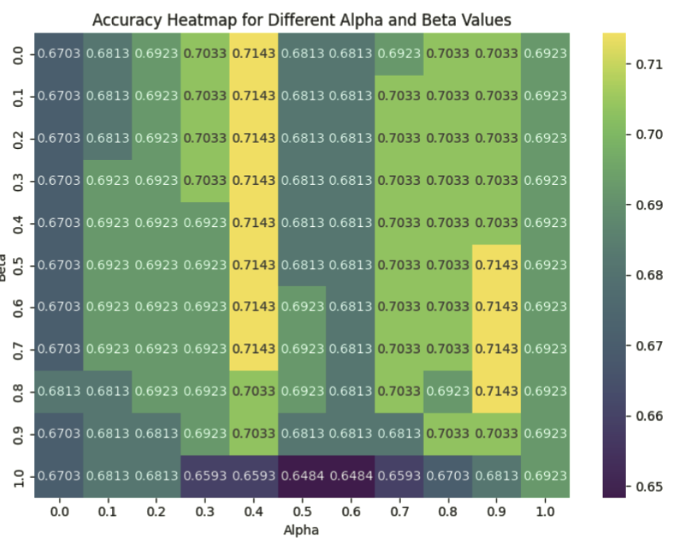
Grid Search

Slide 24
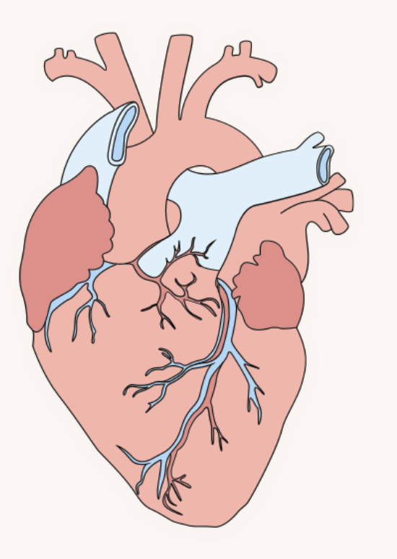
04
Conclusion

Slide 25
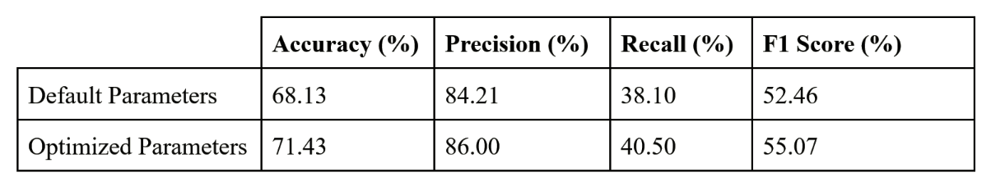
Results

Slide 26
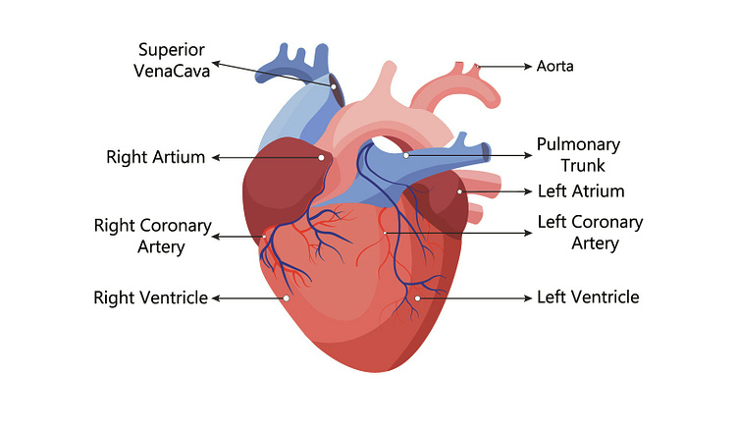
Future Work
Hyperparameter tuning using cross-validation
Application to other high-dimensional medical datasets
Hybrid models that integrate adaptive KNN

Slide 27
Sources
Liebman J. (2002). Nonarrhythmia clinical electrocardiography--can it be returned to clinical
viability? Journal of electrocardiology, 35(4), 293–298.
https://doi.org/10.1054/jelc.2002.36273
University of Rochester Medical Center. (n.d.). Arrhythmias. Health Encyclopedia.
https://www.urmc.rochester.edu/encyclopedia/content?ContentTypeID=85&ContentID=P
00195​
Hiremani, V., Devadas, R. M., L, H., S, S., & Pasha, A. (2023). Heart arrhythmia classification using machine learning algorithms. In Proceedings of the 2nd International Conference
on Ambient Intelligence in Health Care (ICAIHC) (pp. 1–4). IEEE.
https://doi.org/10.1109/ICAIHC59020.2023.10431441

Slide 28
Sources
Samad, S., Khan, S. A., Haq, A., & Riaz, A. (2014). Classification of arrhythmia. International
Journal of Electrical Energy, 2(1), 57–61. https://doi.org/10.12720/ijoee.2.1.57-61
Guvenir, H. A., Acar, B., Demiroz, G., & Cekin, A. (1997). A supervised machine learning
algorithm for arrhythmia analysis. In Computers in Cardiology 1997 (pp. 433–436).
IEEE. https://doi.org/10.1109/CIC.1997.647926​
Niazi, K. A. K., Khan, S. A., Shaukat, A., & Akhtar, M. (2015). Identifying best feature subset
for cardiac arrhythmia classification. In Proceedings of the 2015 Science and Information
Conference (SAI) (pp. 494–499). IEEE. https://doi.org/10.1109/SAI.2015.7237188

Slide 29
Sources
mutual_info_classif. (n.d.). scikit-learn. Retrieved March 27, 2025, https://scikit-learn.org/stable/modules/generated/sklearn.feature_selection.mutual_info_cl assif.html StandardScaler. (n.d.). scikit-learn. Retrieved March 27, 2025, https://scikit-learn.org/stable/modules/generated/sklearn.preprocessing.StandardScaler.ht ml NearestNeighbors. (n.d.). scikit-learn. Retrieved March 27, 2025, from https://scikit-learn.org/stable/modules/generated/sklearn.neighbors.NearestNeighbors.htm l

Slide 30
Sources
SimpleImputer. (n.d.). scikit-learn. Retrieved March 27, 2025, from https://scikit-learn.org/stable/modules/generated/sklearn.impute.SimpleImputer.html ColumnTransformer. (n.d.). scikit-learn. Retrieved March 27, 2025, from https://scikit-learn.org/stable/modules/generated/sklearn.compose.ColumnTransformer.ht ml OneHotEncoder. (n.d.). scikit-learn. Retrieved March 27, 2025, from https://scikit-learn.org/stable/modules/generated/sklearn.preprocessing.OneHotEncoder.ht ml Pipeline. (n.d.). scikit-learn. Retrieved March 27, 2025, from https://scikit-learn.org/stable/modules/generated/sklearn.pipeline.Pipeline.html

Slide 31
Sources
PCA. (n.d.). scikit-learn. Retrieved March 27, 2025, from https://scikit-learn.org/stable/modules/generated/sklearn.decomposition.PCA.html Rusafu.com. (n.d.). Arrhythmia Quotes. Retrieved March 28, 2025, from https://rusafu.com/quotes/tag/arrhythmia/​ Corvino, G. (n.d.). Beating Heart [Illustration]. Dribbble. Retrieved March 28, 2025, from https://dribbble.com/shots/11260618-Beating-Heart​ Punkichi. (n.d.). Pumping Heart [Illustration]. Dribbble. Retrieved March 28, 2025, from https://dribbble.com/shots/1963962-Pumping-Heart​ Sandhya. (n.d.). Doctor's Day Dribbble [Illustration]. Dribbble. Retrieved March 28, 2025, from https://dribbble.com/shots/4770653-Doctor-s-Day-Dribbble​

Slide 32
Sources
Zukauskaite, K. (n.d.). Premium Stock: Medical, Health [Illustration]. Dribbble. Retrieved March 28, 2025, from https://dribbble.com/shots/10994835-Premium-Stock-Medical-Health​ Chantale. (n.d.). Heart [Illustration]. Dribbble. Retrieved March 28, 2025, from https://dribbble.com/shots/5288643-Heart​ Northwestern Medicine. (n.d.). How to Read an EKG (Infographic). Retrieved March 28, 2025, from https://www.nm.org/healthbeat/healthy-tips/how-to-read-an-ekg-infographic​ Aakash, M. R. H. (n.d.). Human heart. The heart with a venous system. Anatomy. Flat vector [Illustration]. Dribbble. Retrieved March 28, 2025, from https://dribbble.com/shots/22623314-Human-heart-The-heart-with-a-venous-system-Anatomy-Flat-vecto​

Slide 33
Thank you!

